Slide 1
OEM Design Win of the Month

Slide 2
Elo Wins Trane Commercial HVAC Controller
Design Win of the Month – August 2018
Customer: Trane
Website: www.Trane.com
Industry: Industrial - HVAC
Solution: Elo created a customized 10-inch I-Series 2.0 for Android AiO system to enable home and building automation control for Trane. The Android based system with Trane’s APK loaded and customized power supply enables seamless integration with their global environment. The solution went through rigorous stress tests, ensuring lasting performance and reliability over time.
Elo RSM: Mike Schnelbach
Elo FAE: Paul Futter
Key Value Propositions (at least 3):
Exceeded all required quality and environmental specifications - passing Thermal testing, solder-joint integrity checks and more.
Effectively supported custom software development to facilitate Trane APK load on system startup and preclude unsponsored loading of 3rd party software
Developed custom power supply to meet Trane's secure connection requirements and global connectivity needs.
I-Series Value model expands opportunities to compete and helped win this opportunity even at a higher price point compared to competition.
Scope: A subsidiary of Ingersoll Rand and the successor to the American Standard Companies, Trane Inc. manufactures heating, ventilating and air conditioning systems as well as building systems and controls.
Trane was looking for an Android AiO HVAC Controller solution that was relatively small, could be wall-mounted for indoor use and could pass intense stress testing to ensure efficient operation of device over time.
Potential Other Customers:
Honeywell
Johnson Controls
Carrier
Computrols
Lennox
Distech Controls
Schneider Electric
Delta Controls
Mitsubishi Electric

Slide 3
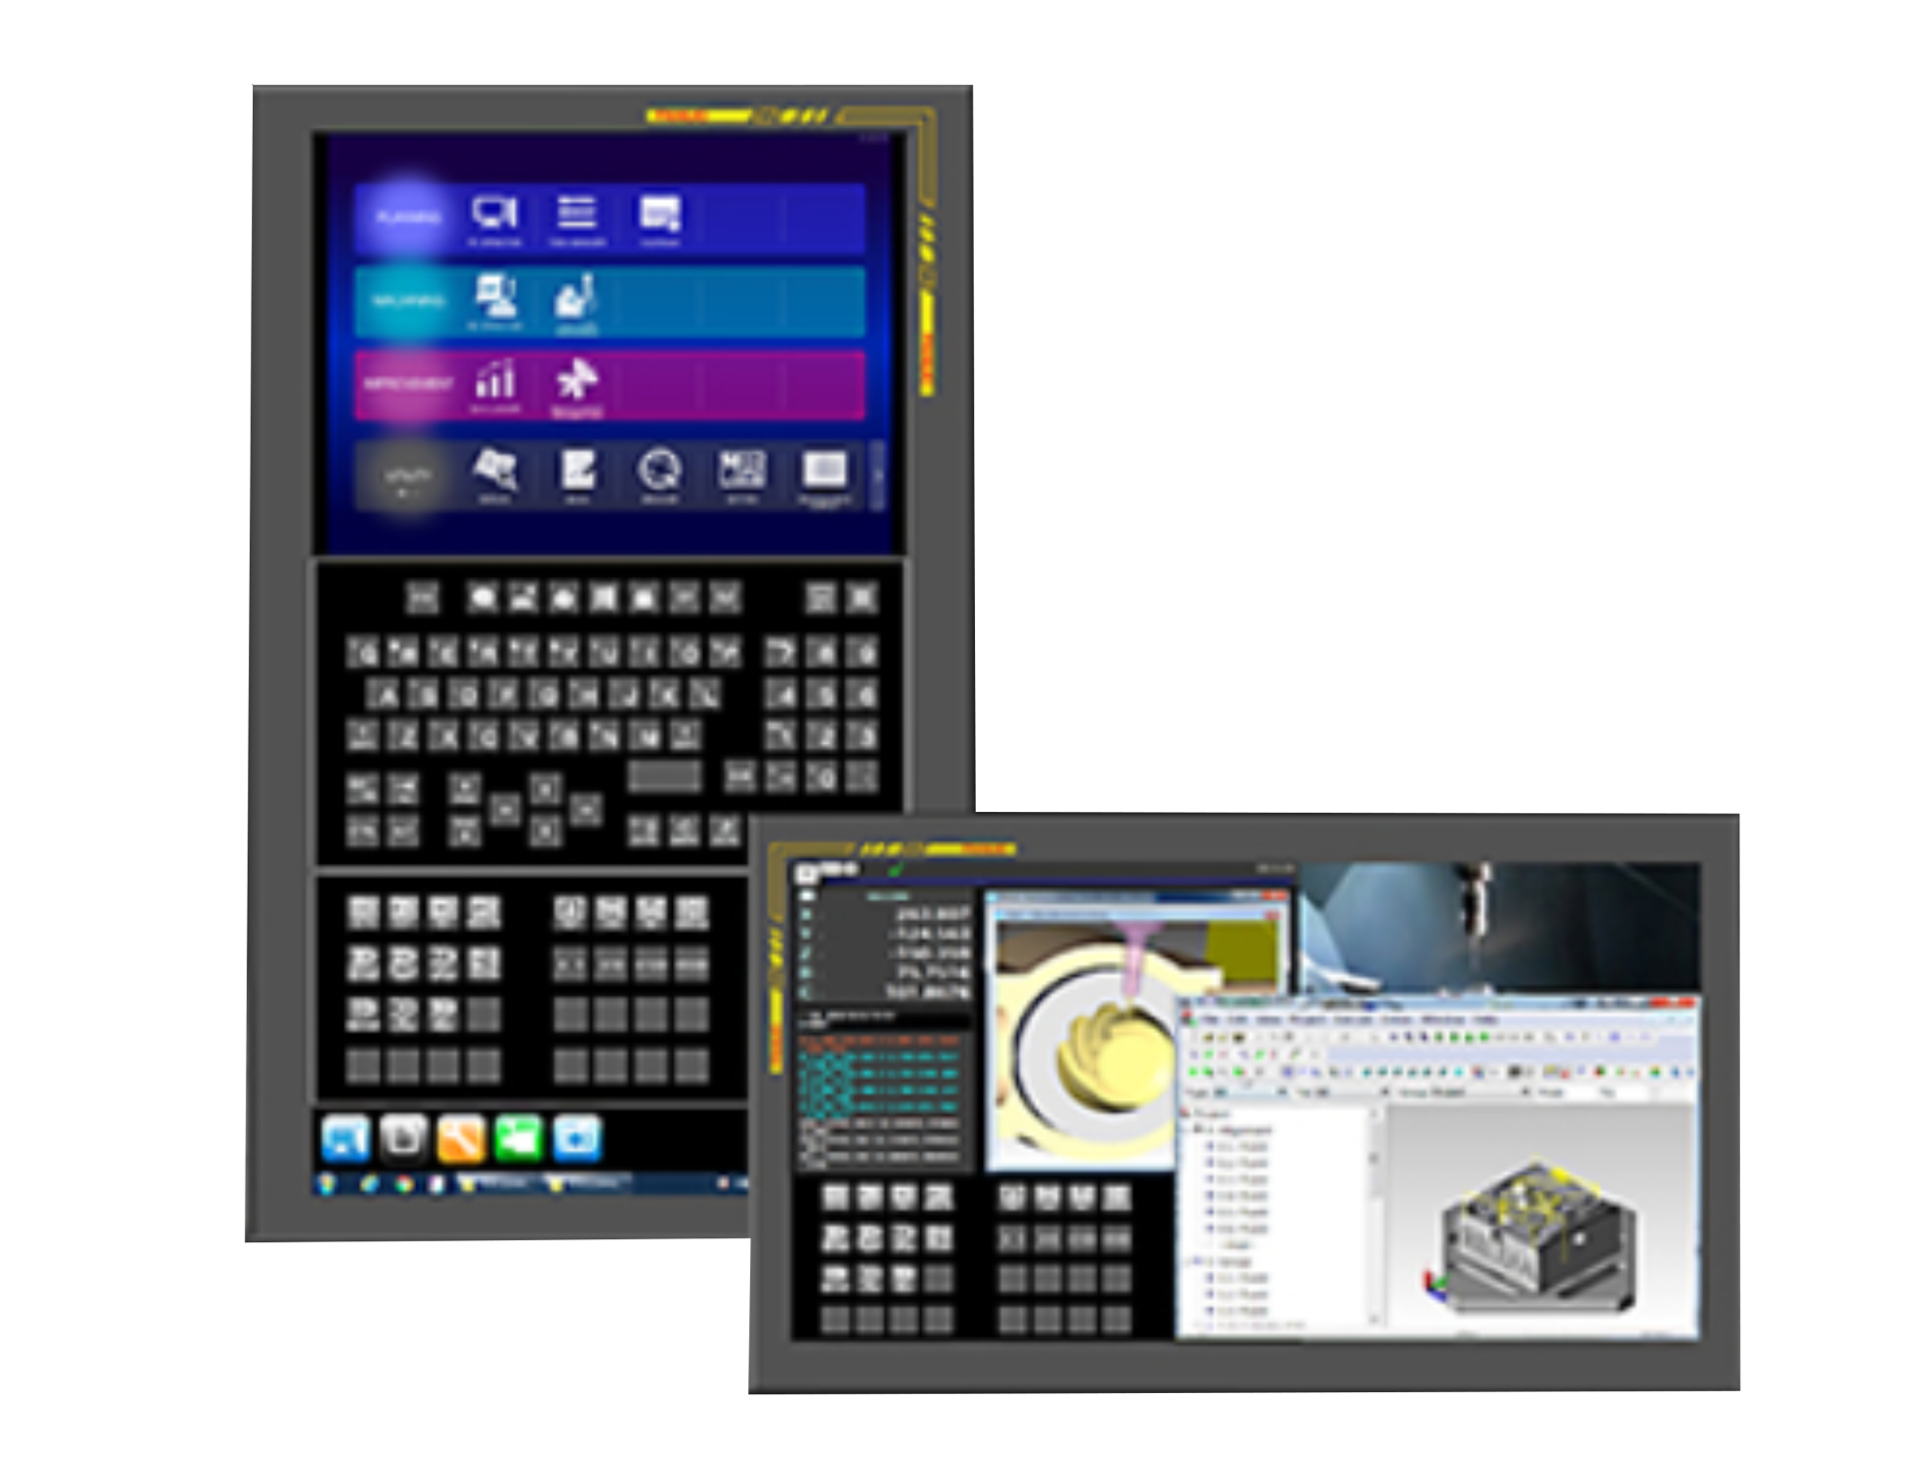
Elo Wins FANUC for Industrial Automation
Design Win of the Month – July 2018
Solution:
Elo’s 21.5” All Glass PCAP touchscreen with 8210 controller was selected as the touchscreen for FANUC’s custom CNC units for its European customers as well as FANUC’s high-end standard CNC units.
Customer: FANUC
Website: https://www.fanuc.co.jp/eindex.html
Industry: Factory Automation
Elo RSM: Hiroshi Kuroki
Elo FAE: Yoshikazu Tanaka
Key Value Propositions (at least 3):
Reliability - All glass touchscreen with the highest durability and reliability, matching FANUC’s Corporate strategy.
Local Technical Service – Controller fine tuning in Japan.
Supply Chain Flexibility - Finished goods inventory in Japan for JIT delivery.
Scope:
FANUC is a global leader of Computer numerical control (CNC) and has produced over 4 million CNC units used to control factory automation machines around the globe. They are currently using resistive touchscreens and want to see if there is a better option.
Potential Other Customers:
Mitsubishi
Topre
HAAS
Husky
Siemens
Rockwell
Mettler Toledo
Beckhoff Automation
Schneider
Honeywell
21.5” 3GS PCAP touchscreen with 8210 controller used in FANUC PANEL iH Pro with 21.5’’ widescreen LCD
www.automationworld.com/leaders

